Slide 1

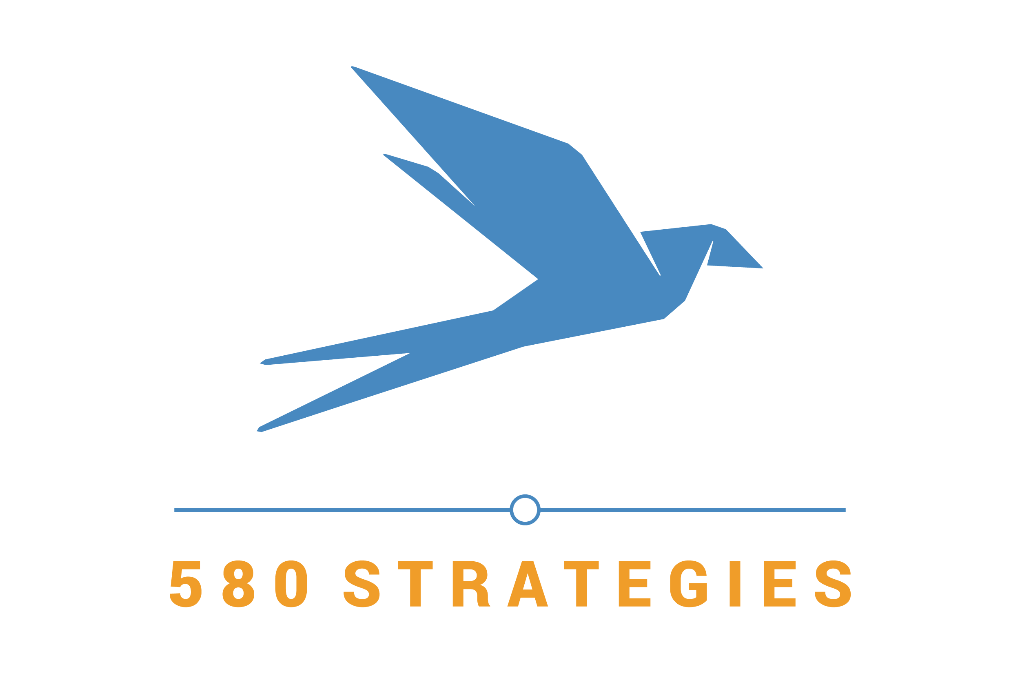
DevOps Best Practices
Task Order #59
for:
U.S. Department of Veterans Affairs
Rusty D. Pickens
Founder and Principal
David Colangelo
Lead Engineer

Slide 2
The VA DevOps Process
10-steps beginning with understanding the need and ending with working software that can quickly be iterated upon.
Ticket
and
Define
Develop
Build Artifacts
Approve
Pull
Request
and
Code
Review
Dev
Ops
Production
Deployment
Understand
Merge,
QA Deploy, and Verify
Functional
Testing
Measure
Iterate

Slide 3
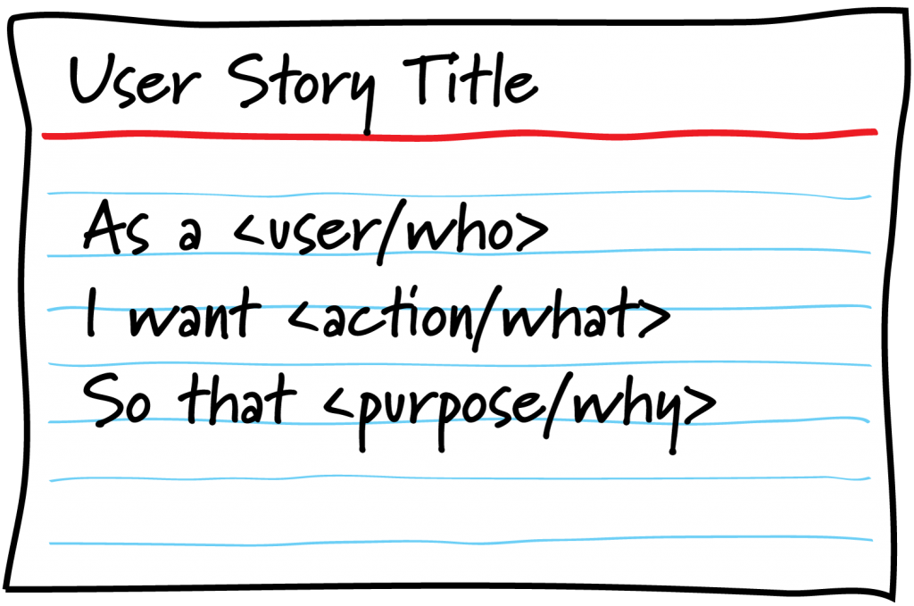
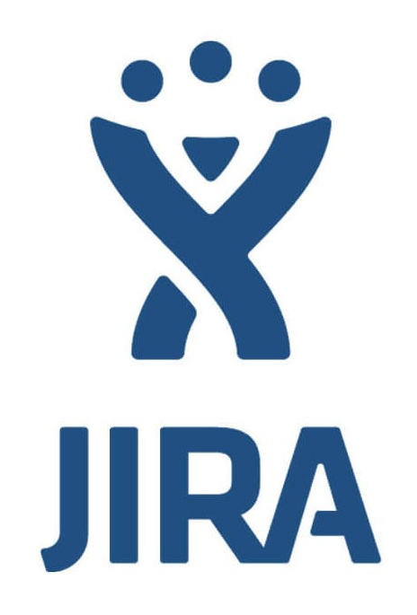
Ticket Management
Ticket
and
Define
Properly formed user stories:
As a [role], I want to [action], so that [business value].
Including Acceptance Criteria and size estimation
Includes:
Scrum or Kanban support
Collaboration features
Robust reporting and tracking
Our recommendation:
Jira

Slide 4
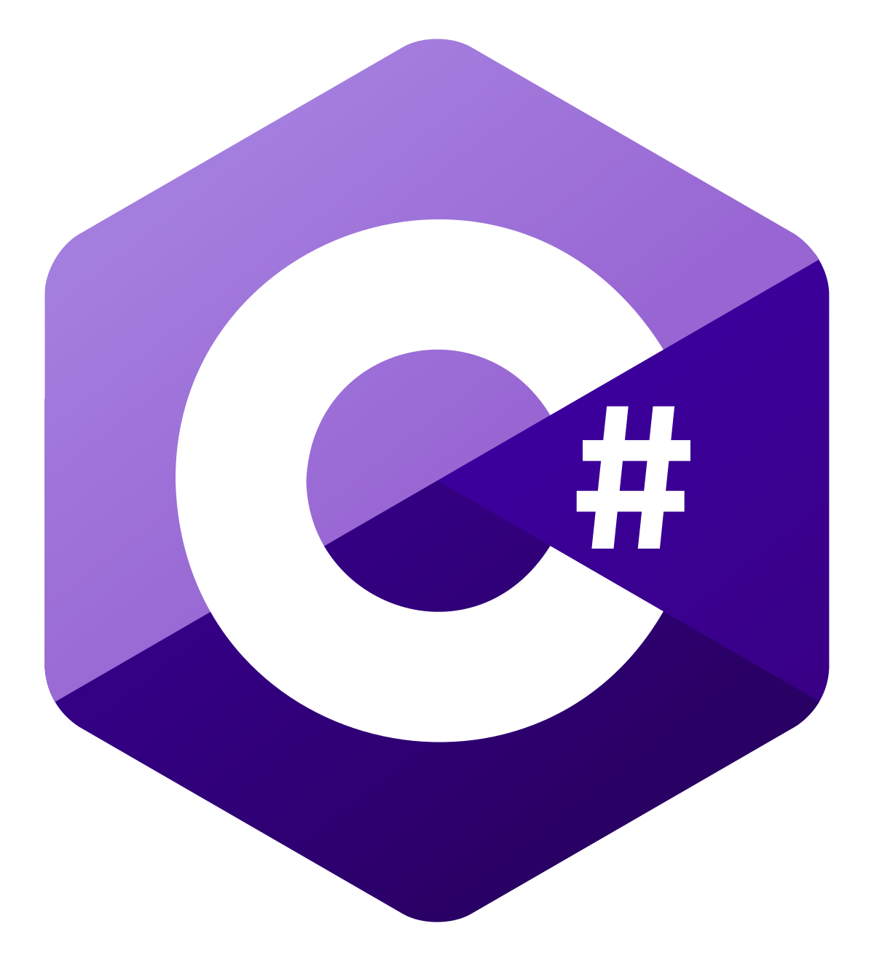


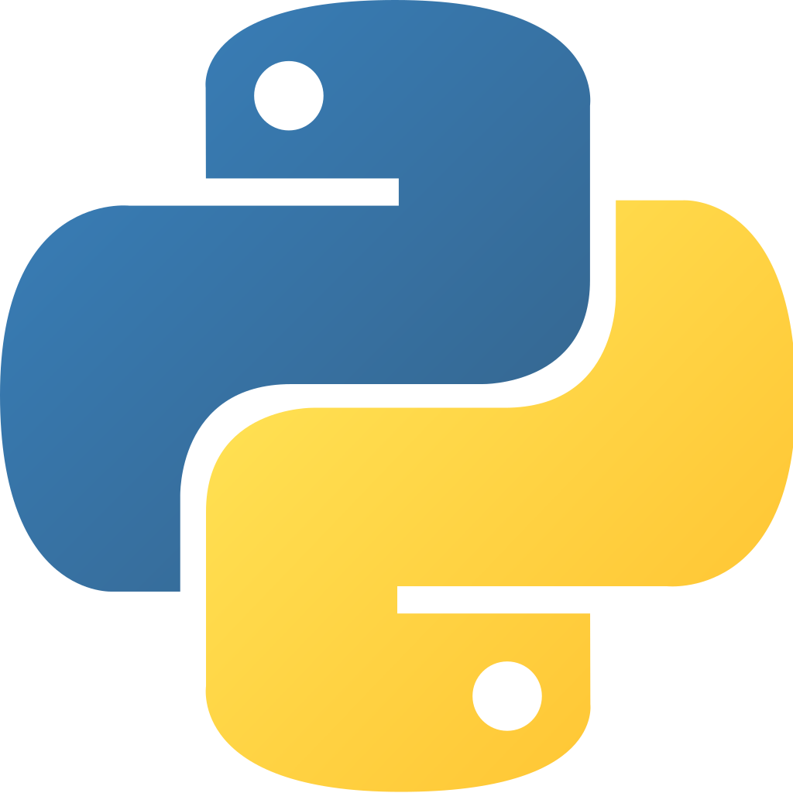
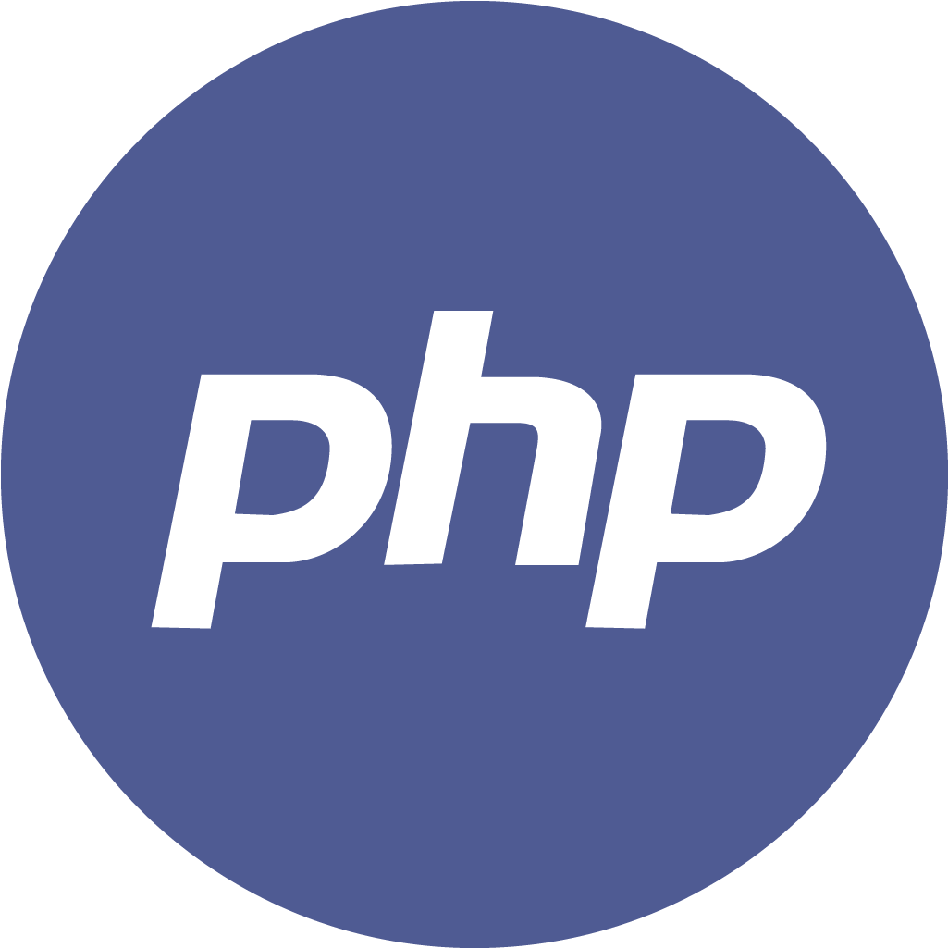
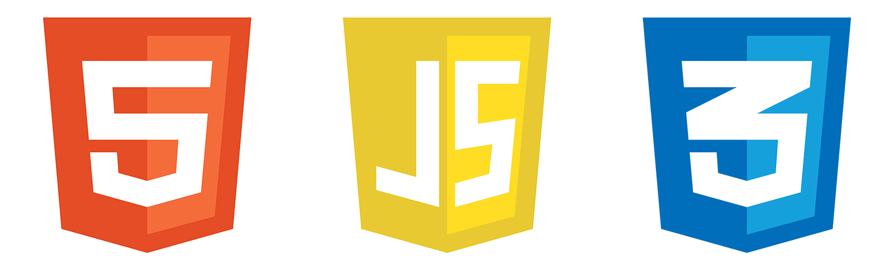
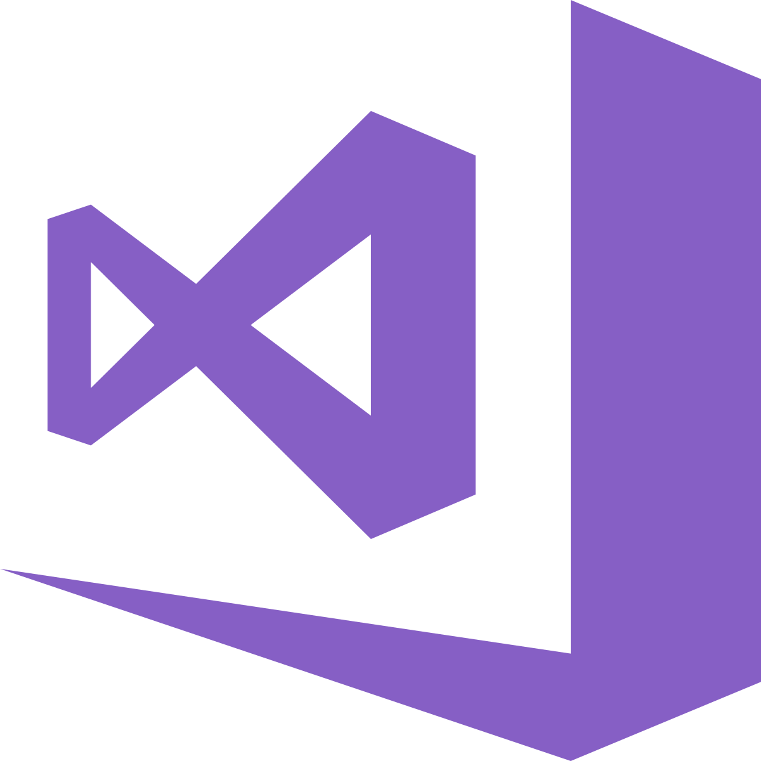
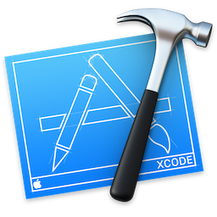

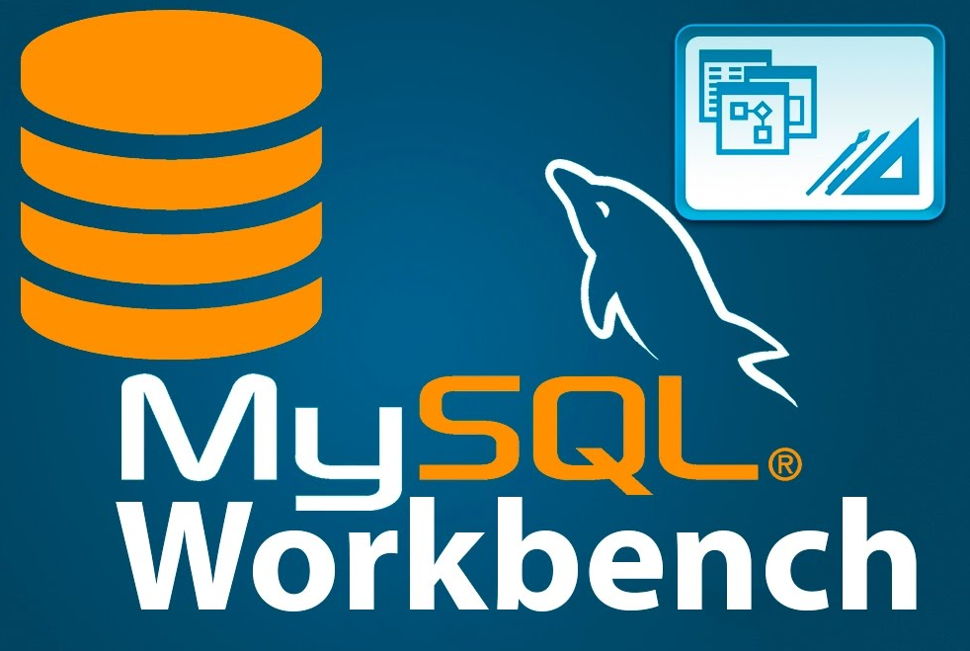
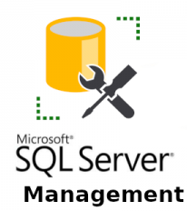
Product-specific Tools
Develop
Development efforts should be:
Localized within containers
Feature-based with dedicated git branches
Written with as-close-to-native tools as possible
Conforming to language-specific best practices
Our recommendation:
Visual Studio, Xcode, or JetBrains
C#
Swift
Visual Studio (Microsoft)
Xcode
(Apple)
JetBrains (Everything else)

Slide 5
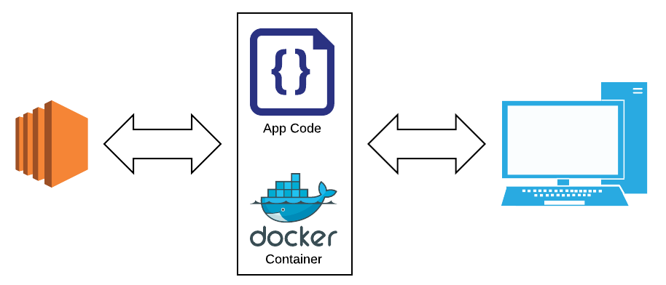
Containerization
Develop
Provides:
Uniform and scalable development environments
Process-driven, standardized testing
Isolation from other systems
A repeatable deployment and development process
Our recommendation:
Docker

Slide 6
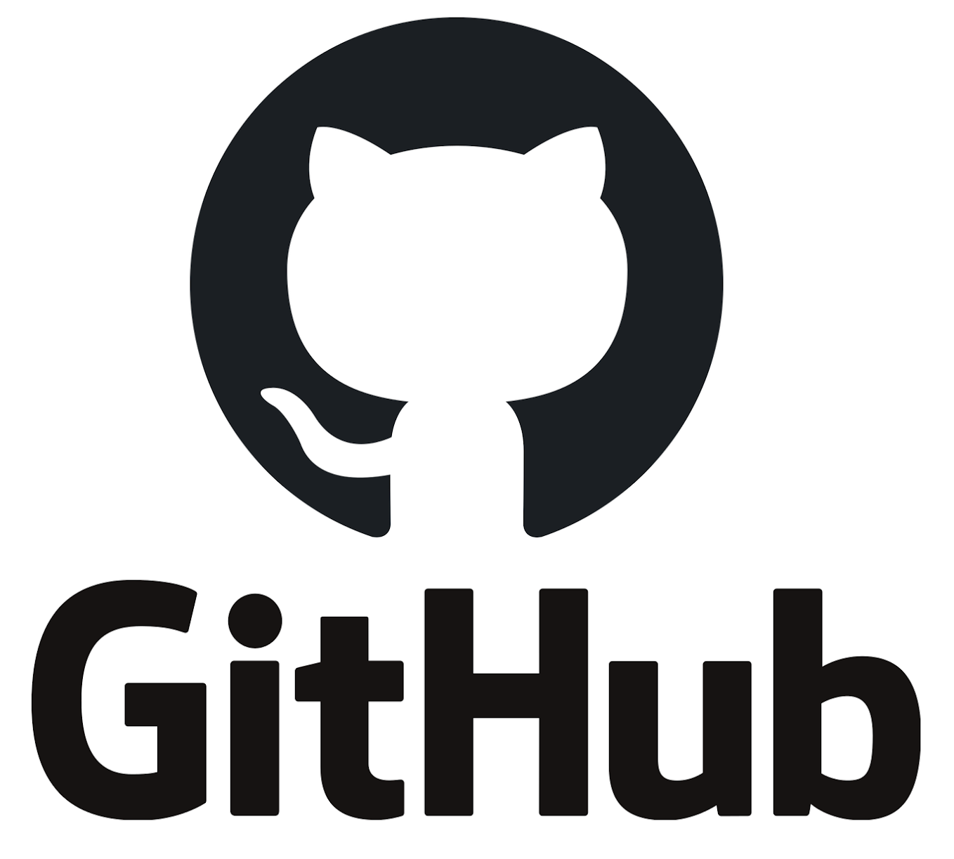

Code Management
Pull
Request,
Code
Review
Functional
Testing
Managing development with git provides transparency, granularization, and process governance control.
Code is managed through branches and pull requests.
Each new feature is automatically tested before merging.
Our recommendation:
Git
Jenkins (CI/Testing)
Jenkins
Master
New Merge Commit
Feature
Branch
Code
Review

Slide 7

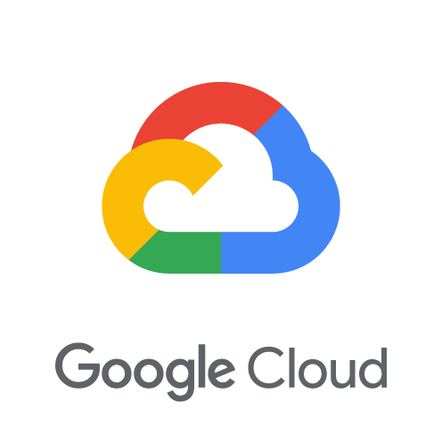
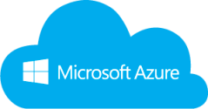
Merging and Deploying
Merge,
Deploy, and Verify
After automated unit testing and code review, merging code into the various branches and testing in the larger product environment before production release is essential. To manage this we recommend using Infrastructure as Code coupled with a robust CI/CD platform.
Our recommendation:
Jenkins (CI/CD)
Terraform (Environment Definition)
Jenkins

Slide 8
Process Governance
Code Review
Approve
Leveraging the power of GitHub, VA can ensure transparency, source code control, and governance by empowering staff to accept new development work from a variety of sources. As process checkpoints and prerequisites are met, new code can be introduced into higher-level branches and deployed to production with minimal risk.
Systems
Integrators
Citizen
Developers
Government
Acceptance
Production
System
Platform
Vendors

Slide 9
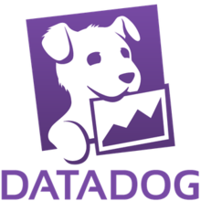
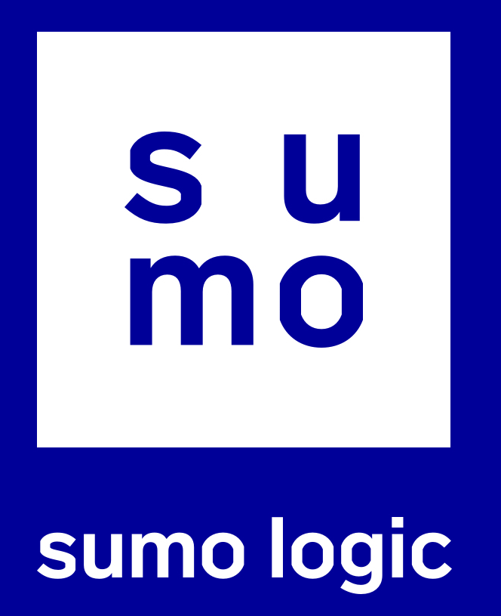
Measurement is Key
Measure
Monitoring system changes after release is key. A good DevOps ecosystem will provide both platform level monitoring as well as log capture so that engineers can quickly identify and remedy any unexpected incidents.
Our recommendation:
DataDog (Environment Monitoring)
SumoLogic (Logging)

Slide 10
THANK YOU
Our mission is helping you achieve your mission supporting our veterans.
Thank you for the opportunity to work together.
580Strategies.com

